Slide 1
How to prepare a CLIL Lesson in 15 minutes
Tuesday March 10th 2020
Notes:
Eventuele toevoeging: Balans over taal en subject (Ting) en het gebruik van scaffolding hiervoor, en de 3 principes van Phil Ball en de link met scaffolding om dit te supporten

Slide 2
What to expect
A ‘’ template” of sorts for your CLIL lesson
A variety of activities to implement CLIL to your lesson
My step-by-step procedure to prepare my CLIL lessons in 15 minutes
Inspiration and ideas to use in your CLIL lesson, tomorrow

Slide 3
At the end of this workshop
You will have discovered what CLIL is
You will have learned how to apply it in your lesson
You will have explored a variety of activities to try
You will have experienced these activities yourself
But most importantly: be inspired!

Slide 4
Who is this for?
What is your level of expertise of CLIL, measured in years?

Slide 5
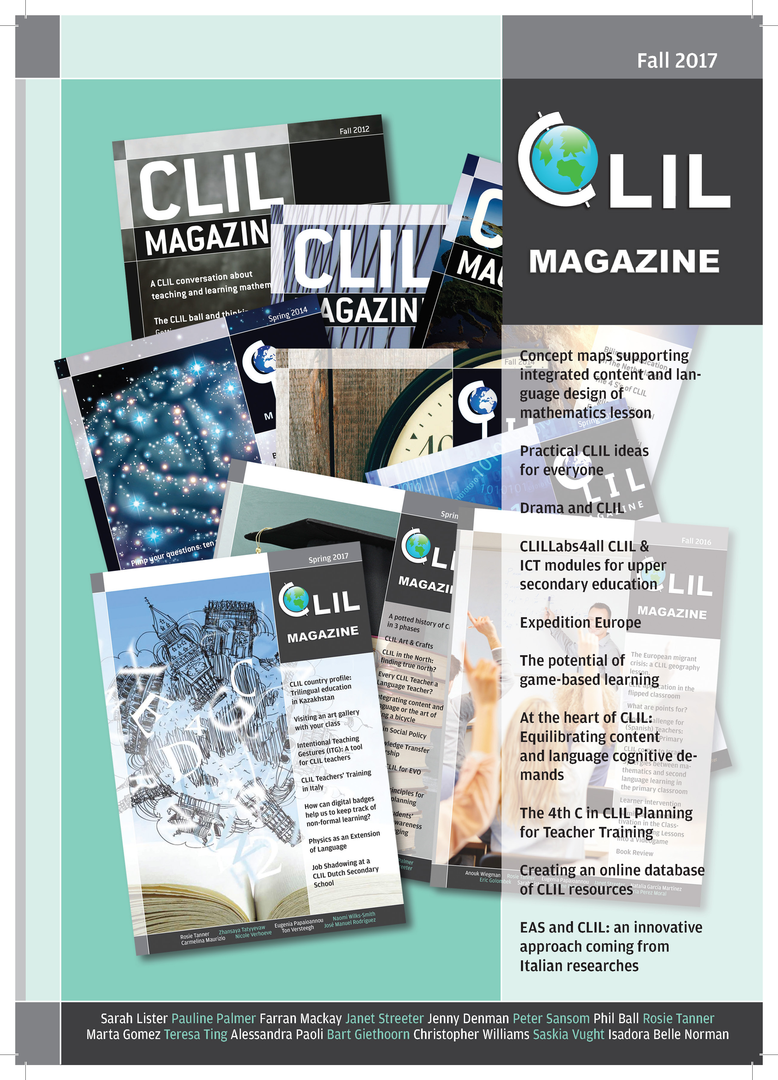
Who am I?
CLIL student
CLIL Maths teacher
CLIL Coach
Chief editor CLIL Magazine
CLIL teacher trainer/Online courses

Slide 6
What is CLIL?

Slide 7
Activity: Finish the sentence
Copy and finish the sentence:
CLIL is..
CLIL is..
CLIL is..
CLIL is..
CLIL is..
Try to complete them all!
Notes:
CLIL and Bilingual education

Slide 8
My definition of CLIL
Language is involved (preferably output)
Students are engaged

Slide 9
Ow, just a few more things..
Workshop
Baby steps
I speak fast..
Your own situation

Slide 10
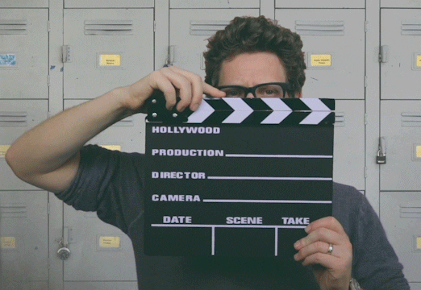
Get down to action

Slide 11
Activity: Answer the questions
Copy these questions and answer them while you listen to my ‘instruction’
What are the four lesson stages we will discuss?
Why did I change the name of the second one recently?
What makes CLIL different from regular teaching?

Slide 12
Four lesson stages
Opening
Informing
Applying
Reflecting

Slide 13
Activity: Answer the questions - recap
What do you think were the answers?
What are the four lesson stages we will discuss?
Why did I change the name of the second one recently?
What makes CLIL different from regular teaching?

Slide 14
What made this a CLIL activity?

Slide 15
Opening
Three (possible) elements of an opening:
Goal of the lesson
Lesson planning
Activate prior knowledge
Notes:
Notice I did all of these at the beginning of this workshop

Slide 16
Activity: Scrambled word
dunoteaic
ntcotne
euaanglg
ettireadng
fetrlnceio
giialnbul

Slide 17
Activity: Scrambled word answers
education
content
language
integrated
reflection
bilingual

Slide 18
Informing
Challenging stage to keep students engaged
“Answer these questions” is one way to this
“Listening dictation” is another….

Slide 19
Activity: Listening dictation
Take notes of what I am going to tell you
Afterwards, compare your notes with your partners and try to come up with one complete tekst
Ready?
Notes:
Tekst nog maken

Slide 20
Listening dictation text
Informing students is often teacher-centered, especially when plenary instructions are applied.
Often teachers want students to take notes during this lesson stage.
This is the perfect opportunity to create engagement.
But at the same time, this particular skill of note-taking is never taught.
We just assume students have this skill already.
Using scaffolding, students can learn this skill.
Start by asking them to copy only the colored part of the instruction, or provide a gapped text to fill out.
Only to do this particular activity at the end, because it is the hardest one.

Slide 21
Listening dictation - recap
What made this activity CLIL?
Rewarding points for key words
Just choose a text from your text book!

Slide 22
Applying
The lesson stage students have to apply what they learned.
What could possibly go wrong..?

Slide 23
Activity: What do I want to say?
Individual learning
Use of language
Engagement

Slide 24
Activity: What do I want to say?
Individual learning
Use of language
Engagement
Active learning also happens when students work alone
Motivate language output, f.e. secret student
Students accountable for their own work
Everyone needs to participate

Slide 25
Secret Student
Choose one student you will pay attention to during this lesson
Let your students know you will provide one student with feedback at the end of the lesson (but don’t say who)
Provide the student with feedback at the end, be sure to include positive feedback as well!

Slide 26
Reflecting
The most forgotten stage
Takes only a couple of minutes, but gives a lot of information

Slide 27
On a scale of 1 – 10…
So far, rate your own level of understanding of CLIL
Raise your hand if it is a 6 or higher
What information does this provide me?
Or provide you at the end of your own lesson?

Slide 28
How to do this in 15 minutes..

Slide 29
Step by step procedure
Determine lesson goals (3 min.)
Determine student work (3 min.)
Determine lesson stages (2 min.)
Determine CLIL activities needed (5 min.)
Check to see if I did not miss anything (2 min.)

Slide 30
Example lesson

Slide 31
3. Determine lesson stages
Boring?

Slide 32
4. Determine CLIL activities
One for each stage

Slide 33
Fill in the gaps

Slide 34
List of activities we discussed
Answer the questions
Scrambled word
Listening dictation
What do I want to say?
Secret student
On a scale of ..
Problem of the day
Fill in the gaps
Homework presentations
Lesson recap

Slide 35
CLIL activities in your lesson
Which one of the these actitivies is something you could use in your lesson?
Think about this for a couple of minutes, I will ask some of you to share your lesson idea afterwards
Answer the questions
Scrambled word
Listening dictation
What do I want to say?
Secret student
On a scale of ..
Problem of the day
Fill in the gaps
Homework presentations
Lesson recap

Slide 36
Activity: Workshop recap
I provided you with a template & my step-by-step procedure
I provided you with a variety of CLIL activities (and made you experience a few of them along the way)

Slide 37
Finishing up
Want these digital resources? Leave your email address
Powerpoint presentation
Digital list of CLIL activities
Optional: Free course on how to prepare a CLIL lesson in 15 minutes
Please fill out the short survey regarding this workshop

