Slide 1
Online leren & professionalisering
ICT in het Vlaamse Onderwijs
22 oktober 2018
Getuigenis van Marie-Leet Bens

Slide 2
Hoe online leren inzetten voor professionalisering?
Ga de uitdaging aan!
Projecten met eTwinning
Blogging
Tools for education
eTwinning & Future Classroom Lab – Online Learning Events & Webinars
School Education Gateway
MOOC & Online courses
Social Media

Slide 3
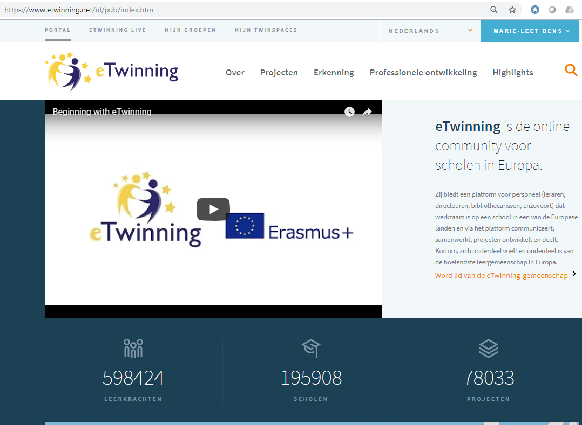
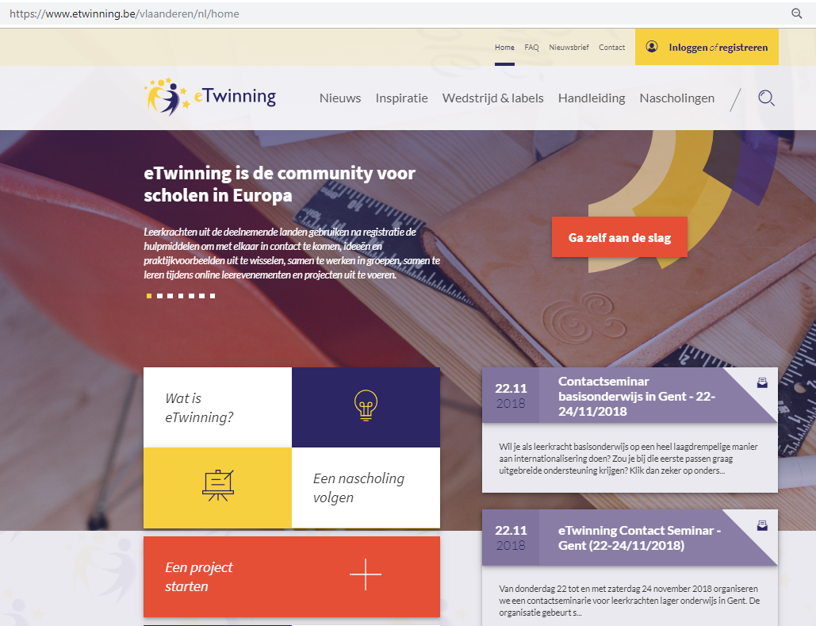
1) Projecten realiseren met eTwinning
https://www.etwinning.net
https://www.etwinning.be/vlaanderen

Slide 4
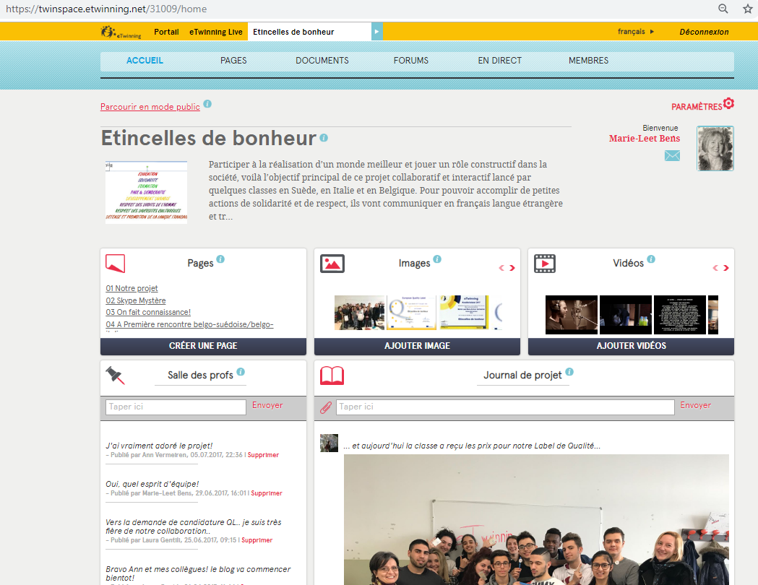
1) Uitwisselen en projecten realiseren en met eTwinning
Twinspace
&
Twinblog

Slide 5
2) Blogging
Project blogs
https://culture-jeune.webnode.com/
https://modejeune.wordpress.com/
https://jeunesenforme.wordpress.com/
https://mauskatti.wordpress.com/
Personal blogs
https://padlet.com/BensBel/LearningDiary
https://spark.adobe.com/page/N9yPB/
Following blogs
https://pedrodebruyckere.blog/
http://www.delenderwijs.net/
https://sonyavanschaijik.com/author/ulimasao/
http://www.juftaniaonline.be/
…

Slide 6
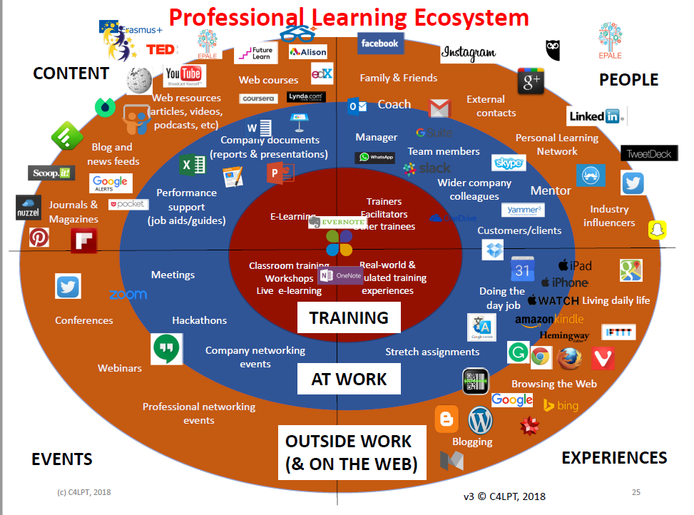
3) Tools for education
Projecten & presentaties eTwinning & CLIL
https://www.educaplay.com/
https://learningapps.org/
https://padlet.com/
ps://quizlet.com/MLBens
https://www.scoop.it/t/learning-languages-discovering-art-exploring-web-tools
htthttps://www.slideshare.net/BensBel
IT-tapas…
Jane Hart
https://www.toptools4learning.com/home/

Slide 7
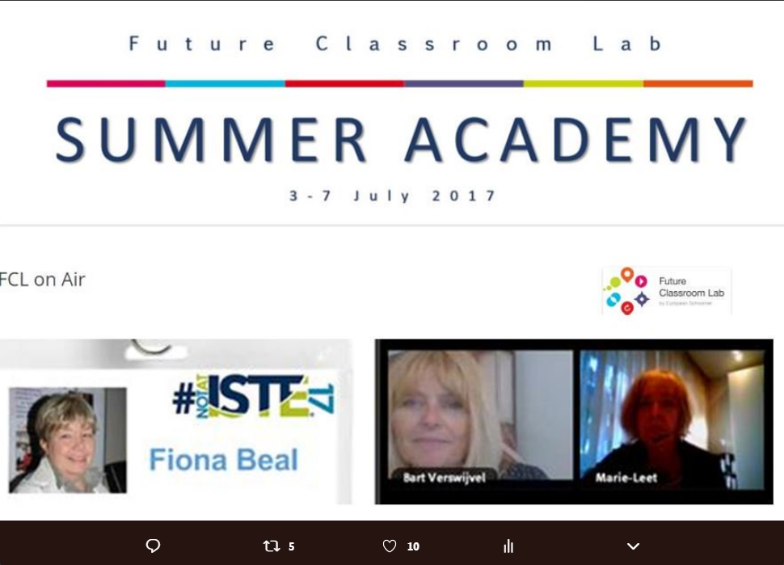
4) eTwinning & Future Classroom Lab
Online Learning Events
Augmented eTwinning Reality
eTwinning and Social Media
Flipped Classroom
The Networked Teacher
Learning in a Museum
Webinars
Global Networking Webinar
Creativity & Innovation
eTwinning Groups
Creative Teachers
On s’amuse en classe FLE
European Network of eTwinning Teachers
Entrepeneurship in Education

Slide 8
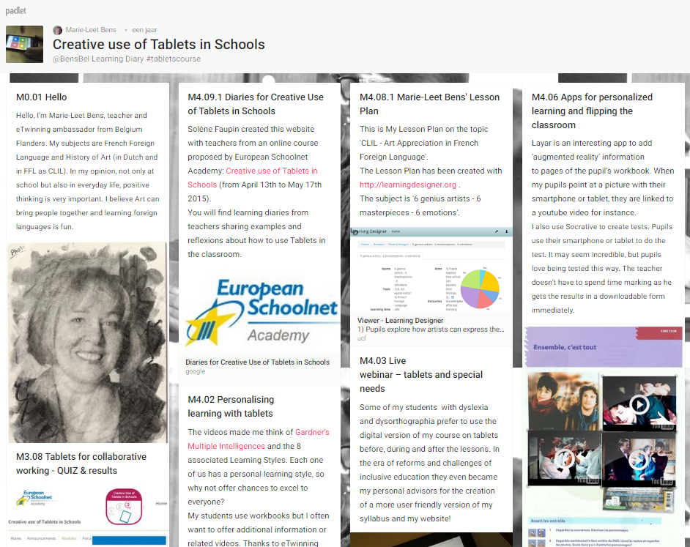
5) School Education Gateway
Future Classroom Scenarios
Creative Use of Tablets in Schools
Games in Schools
Project Based Learning
Creativity & Innovation
…
https://www.schooleducationgateway.eu/en/pub/index.htm

Slide 9
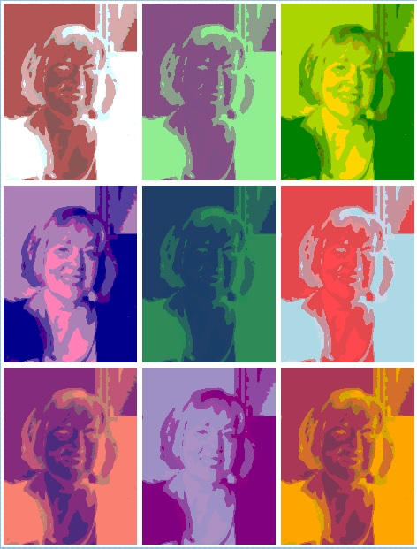
6) MOOC & Online courses
Une brève histoire de l’art https://culture.solerni.com/mooc/view.php?courseid=123
Initiation à l’histoire des arts https://www.louvre.fr/initiation-l-histoire-des-arts
Learning languages https://lyricstraining.com/
The Polyglot Life – Effortless Conversations (Lukas Van Vyve) https://thepolyglotlife.com/

Slide 10
7) Social Media
Twitter edchats
#etwion
#etwiam
#edchat
#edchatEU
…
Twitter ideeën
https://padlet.com/BensBel/mindset
…
Twitter Netwerk
Pedro De Bruyckere – @thebandb
Karen Van de Cruys – @karenvdc
Tania Bruggeman – @jufTania
Hans Hendrikx – @HendrikxHans
Arjana Blazic – @abfromz
Bart Verswijvel – @bartverswijvel
Shelly Sanchez Terrell – @ShellTerrell
…
Marie-Leet Bens – @bensbel

Slide 11
7) Social Media
Facebook Groups
Lesideeën Secundair Onderwijs
EduNext
Competences Course Teacher Academy
eTwinning Social Network
…
Youtube
Ted Talks Education
…

Slide 12
Online leren & professionalisering
ICT in het Vlaamse Onderwijs
22 oktober 2018
Marie-Leet Bens

